Slide 1
Python: Strings
Lesson 2

Slide 2
Review
Last lesson, we went over:
What is Programming?
The Print Statement
Comments
Data Types
Variables
Numbers
Booleans
Strings
Now we will do some review questions for last lesson.

Slide 3
Review Questions
What does the print() statement do?
Nothing
Displays a message on the screen
Multiplies 2 numbers together
Prints out a piece of paper
Correct Answer:
B

Slide 4
Review Questions
Correct Answer:
D
What function do comments serve?
Nothing
Displays a message
Opens a browser
They describe what the code does

Slide 5
Review Questions
What data types are in Python?
Number
Boolean
String
All of the above
Correct Answer:
D

Slide 6
Review Questions
What will the output of this program be? Remember that if a variable is assigned a new value, it replaces the value of the older one. Type your response into the chat box.
var1 = 3 var2 = “lemon” var3 = 10 var2 = “apple” var3 = “orange” print(var2, var3) print(var1)
Correct Answer:
appleorange
3

Slide 7
Strings - Length
You can find the length of a string using the len() statement. For example, the statement
print(len(“Hello World”))
will print out 11, because there are 11 characters in this string.
Basically, len() takes in a string, and returns a number (the length of the string).

Slide 8
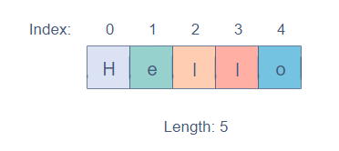
Strings - Index
In a string, every character is given an index based on its position.
The index of the first character is always 0, and the last index is the length of the string minus 1.
For example:
Index is like the order of each character in the whole string - H is 1st, e is 2nd, etc. Remember that the index starts at 0.
Notes:
Indexes arent used only for strings - they have much more use and will be revisited later on

Slide 9
Strings - Accessing Characters
Each character in a string can be accessed using its index. The index must be closed within square brackets, [], and appended to the string. For example,
exampleStr = “Hello There” print(exampleStr[0])
will print the character “H”. This is because index starts counting at 0, meaning the first character is always at index 0.
This works for other indexes as well - index 4 would print the character “o”, index 7 would print the character “h”, etc.

Slide 10
Strings - Accessing Characters
If you were to run the following code, you would get an error:
exampleStr = “Hello” print(exampleStr[5])
This code is getting the character at index 5 of exampleStr. This does not work because exampleStr is only 5 characters long. Since indexes start counting from 0, it would go 0,1,2,3,4 for each character, meaning index 5 is out of the range.

Slide 11
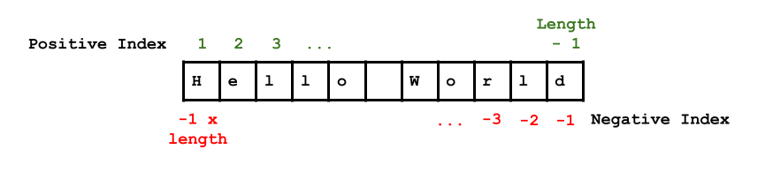

Strings - Reverse Indexing
You can also use negative numbers, which start at the very end. For example, the index -1 is the last character, the index -3 is the 3rd-to-last character, etc.
Length: 11

Slide 12
Practice
What will be displayed by this program?
phrase = “Hello There” print(phrase[0])
Hello There
H
e
Nothing will be displayed.
Correct Answer:
B

Slide 13
Practice
What will be displayed by this program?
phrase = “Hello There” print(len(phrase))
Hello There
10
11
Nothing will be displayed.
Correct Answer:
C

Slide 14
Practice
What will be displayed by this program?
phrase = “Hello There” print(phrase[-3]) print(phrase[len(phrase)-1])
e e
T H
Hello There
Nothing will be displayed
Correct Answer:
A

Slide 15
String Slicing
You can take more than just one character from a string - you can take an entire section of a string.
This section is known as a substring, and this is how you get a substring in code:
string[start:end]
when start and end is the starting index, and end is the last index.

Slide 16
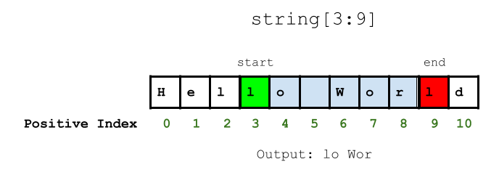
String Slicing
This is a diagram that shows an example string slice, taking index 3 - 9.
Remember that the character at the start index is included in the substring, but not the character at the end index. If you forget this, your substring will be different from what you expect.
Notes:
Make sure you know that the end character isn’t included in the substring

Slide 17
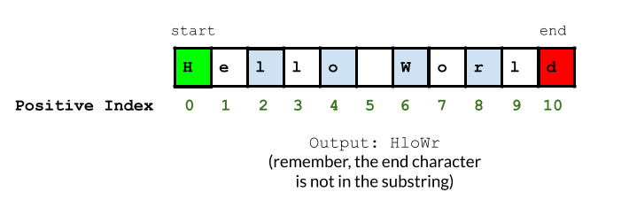
String Slicing
Instead of getting all the characters in between the start and end indexes, you can also step over some of them. The way you do this is:
string[start:end:step]
where start and end are the same, while step describes how many characters you step over. For example, the command
string[0:10:2]
would output this →
Notes:
If the step was 3, then it would get one character every 3 times. Etc, etc.

Slide 18
Practice
What will be displayed by this program?
phrase = “Hello There” print(phrase[1:7])
ello T
Hello There
eT
ello Th
Correct Answer:
A

Slide 19
Practice
What will be displayed by this program?
phrase = “Hello There” print(phrase[4:10:2])
oTee
o There
o Ther
oTe
Correct Answer:
D

Slide 20
Kahoot
We will do a Kahoot, which is like an online quiz.
Type the link into the web browser, and then enter the code on the screen.
Then, type your name in. After everyone joins the game will start.
Try to answer the questions to the best of your ability, good luck!
Notes:
This is if there is more time at the end of the lesson. The link will be sent in the chat box, and the kahoot will be presented.

